Slide 1
6.4 The Perceptron

Slide 2
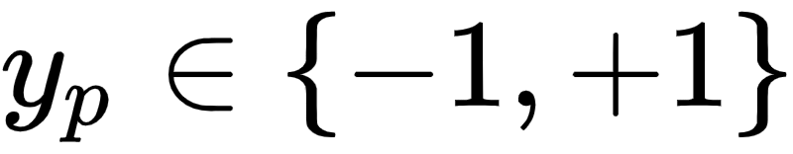
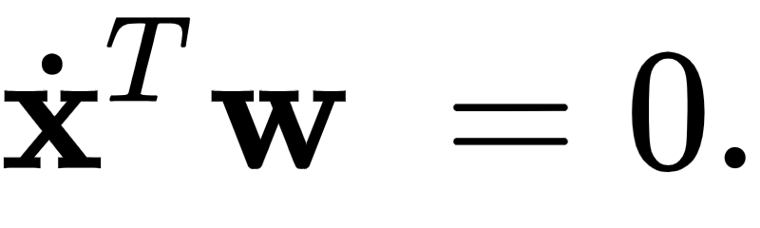
As we have seen with logistic regression we treat classification as a particular form of nonlinear regression (employing - with the choice of label values - a tanh nonlinearity).
This results in the learning of a proper nonlinear regressor, and a corresponding linear decision boundary

Slide 3
Instead of learning this decision boundary as a result of a nonlinear regression, the perceptron derivation described in this Section aims at determining this ideal lineary decision boundary directly.
While we will see how this direct approach leads back to the Softmax cost function.
Practically speaking the perceptron and logistic regression often results in learning the same linear decision boundary, the perceptron's focus on learning the decision boundary directly provides a valuable new perspective on the process of two-class classification.

Slide 4
The Perceptron cost function

Slide 5
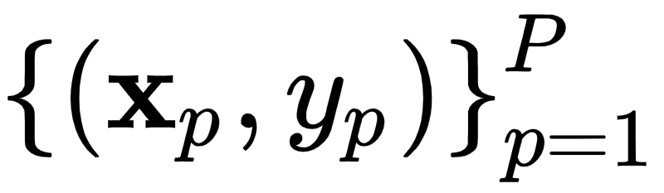
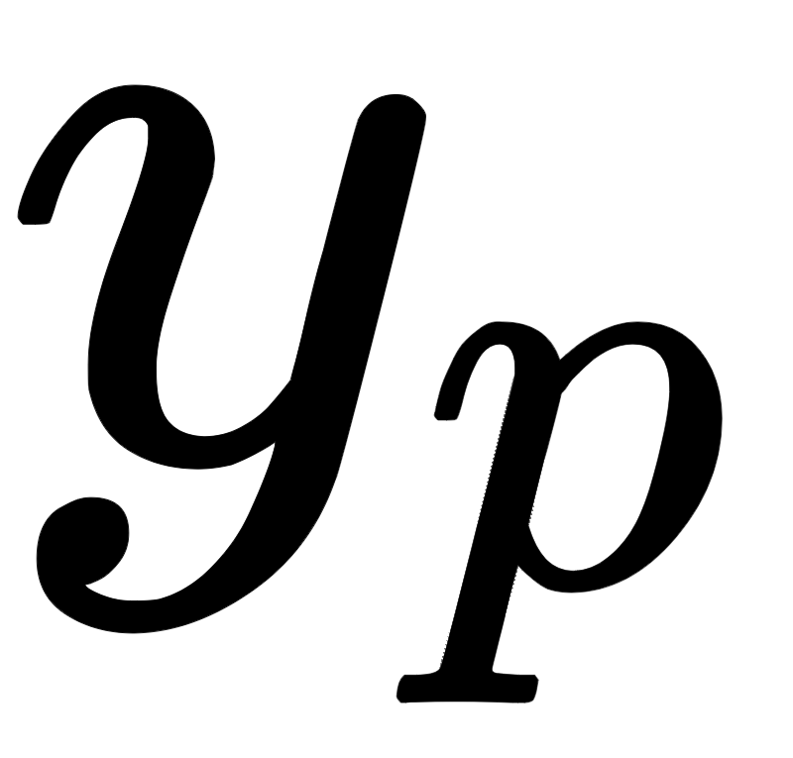
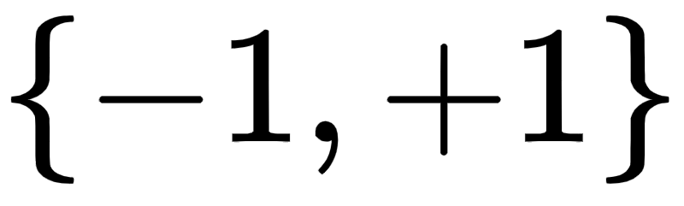
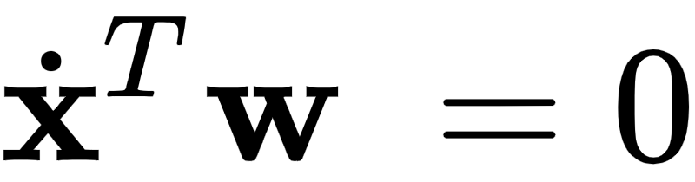
With two-class classification we have a training set of P points - where 's take on just two label values from - consisting of two classes which we would like to learn how to distinguish between automatically.
As we saw in our discussion of logistic regression, in the simplest instance our two classes of data are largely separated by a linear decision boundary with each class (largely) lying on either side.
This decision boundary, written as

Slide 6
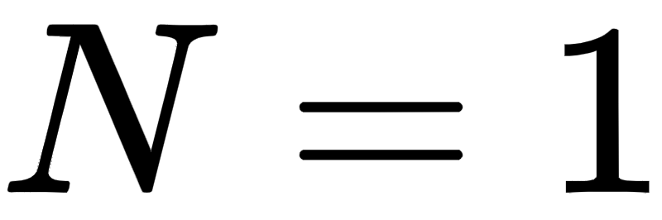
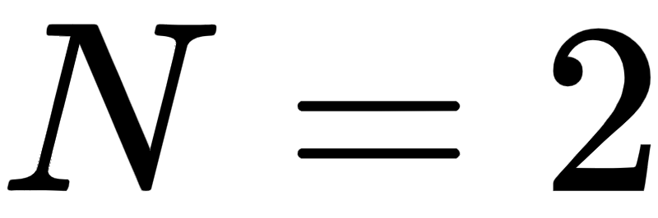
This boundary is a point when the dimension of the input is , a line when , and is more generally for arbitray N a hyperplane defined in the input space of a dataset.
This scenario can be best visualized in the case , where we view the problem of classification 'from above' - showing the input of a dataset colored to denote class membership.

Slide 7
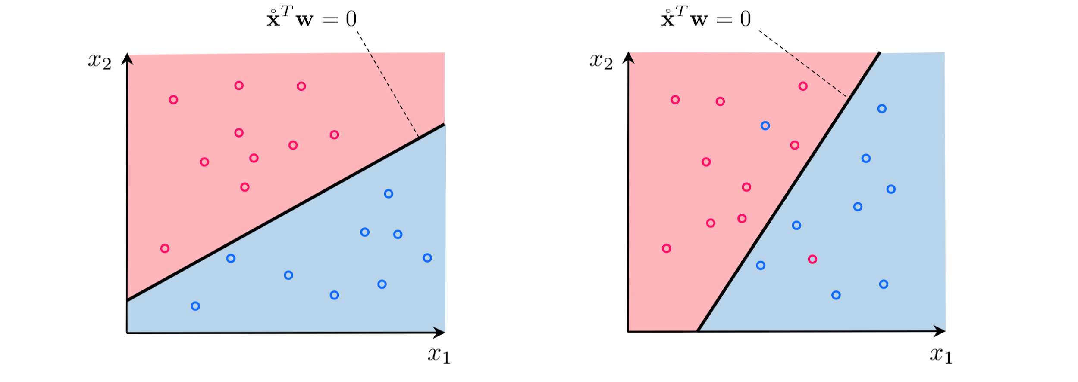

Slide 8
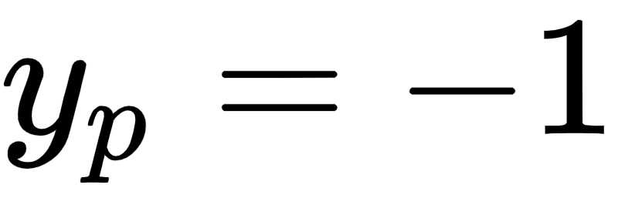
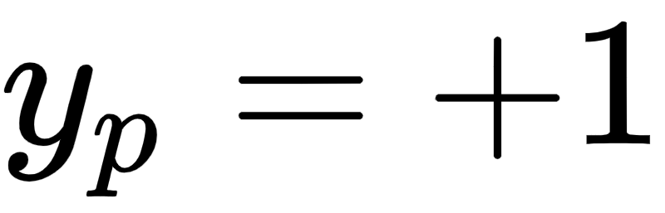
The default coloring scheme we use here - matching the scheme used in the previous Section - is to color points with label blue and red.
The linear decision boundary is here a line that best separates points from the class from those of the class.

Slide 9
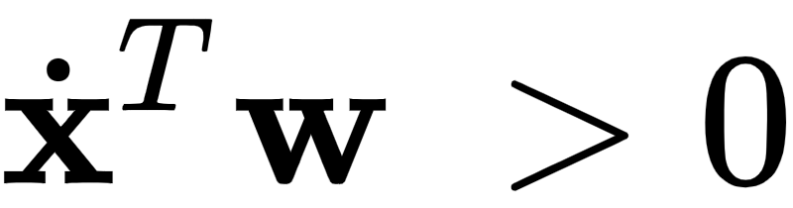
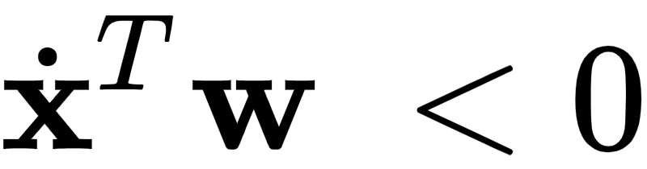

A linear decision boundary cuts the input space into two half-spaces, one lying 'above' the hyperplane where and one lying 'below' it where .
Notice then that a proper set of weights define a linear decision boundary that separates a two-class dataset as well as possible with as many members of one class as possible lying above it, and likewise as many members as possible of the other class lying below it.

Slide 10
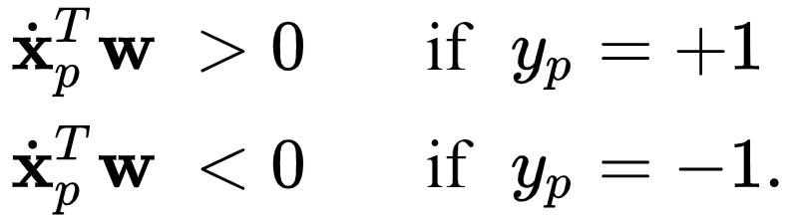
So our desired set of weights define a hyperplane where as often as possible we have that

Slide 11
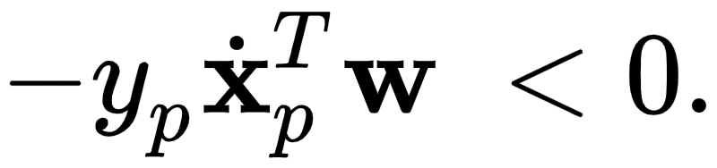
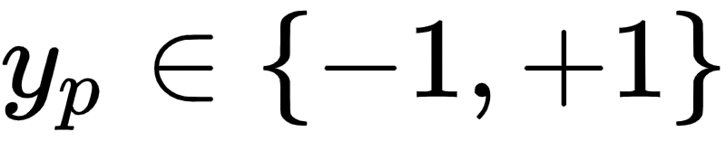

Because of our choice of label values we can consolidate the ideal conditions above into the single equation below
Again we can do so specifically because we chose the label values .
Likewise by taking the maximum of this quantity and zero we can then write this ideal condition as

Slide 12
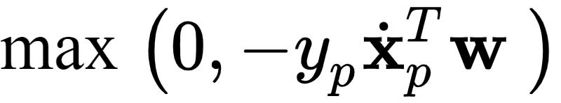
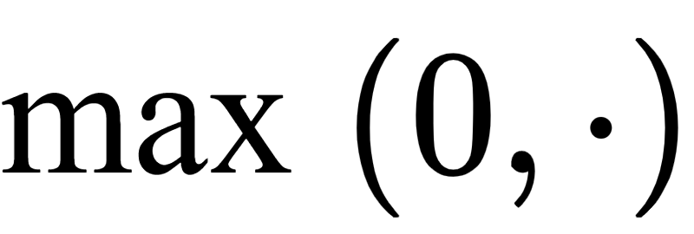
Note that the expression is always nonnegative.
The functional form of this point-wise cost is called a rectified linear unit.
Because these point-wise costs are nonnegative and equal zero when our weights are tuned correctly, we can take their average over the entire dataset to form a proper cost function as

Slide 13
When minimized appropriately this cost function can be used to recover the ideal weights.
This cost function goes by many names such as the perceptron cost, the rectified linear unit cost (or ReLU cost for short), and the hinge cost.
This cost function is always convex but has only a single (discontinuous) derivative in each input dimension.

Slide 14

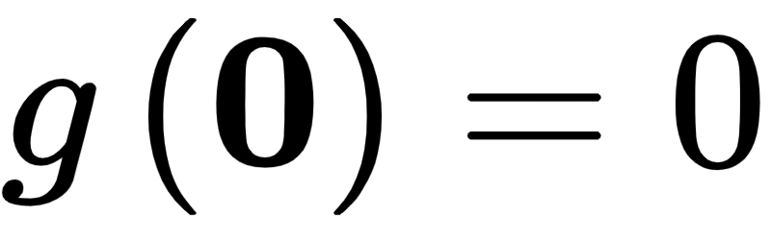
This implies that we can only use zero and first order local optimization schemes (i.e., not Newton's method).
Note that the perceptron cost always has a trivial solution at , since indeed , thus one may need to take care in practice to avoid finding it (or a point too close to it) accidentally.

Slide 15
The smooth softmax approximation to the ReLU cost

Slide 16
Learning and optimization go hand in hand, and as we know from the discussion above the ReLU function limits the number of optimization tools we can bring to bear for learning.
Here we describe a common approach to ameliorating this issue by introducing a smooth approximation to this cost function.
If the approximation closely matches the true cost function then for the small amount of accuracy (we will after all be minimizing the approximation, not the true function itself) we significantly broaden the set of optimization tools we can use.

Slide 17

One popular way of doing this for the ReLU cost function is via the softmax function defined as
Here are any C scalar values - which is a generic smooth approximation to the max function, i.e.,

Slide 18
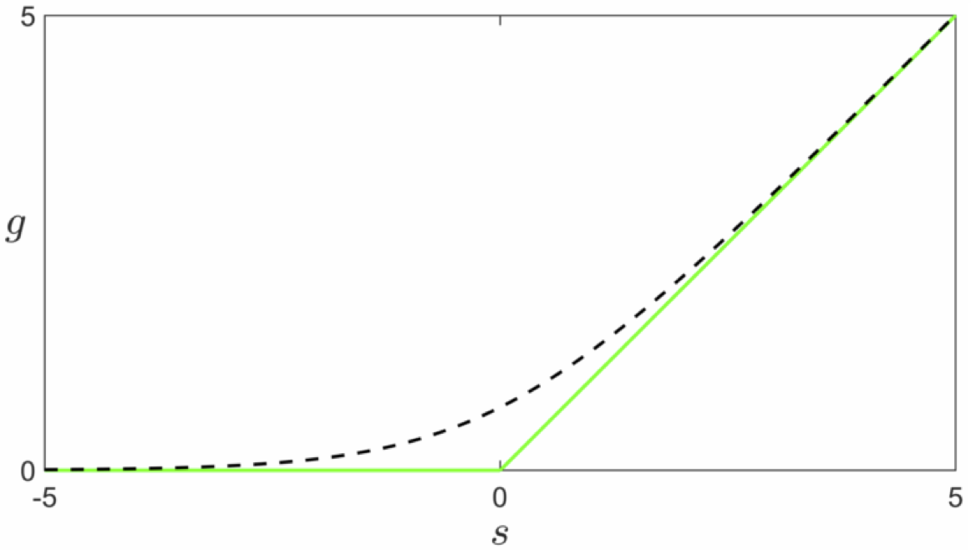
The fact that the softmax approximates the maximum can be proved formally (see text).
Below we show the one dimensional comparison. The softmax is shown in dashed black, and the max in green.

Slide 19
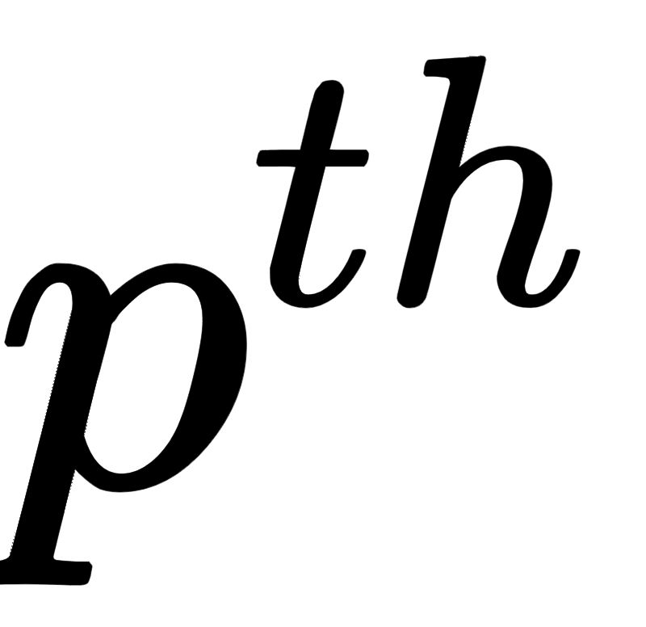
Replace the summand of our ReLU cost with its softmax approximation
The overall cost function is then:
This is the Softmax cost we saw previously derived from the logistic regression perspective.

Slide 20
This is why the cost is called Softmax, since it derives from the general softmax approximation to the max function.
Note that like the ReLU cost - as we already know - the Softmax cost is convex.
However unlike the ReLU cost, the softmax has infinitely many derivatives and Newton's method can therefore be used to minimize it.
Moreover, softmax does not have a trivial solution at zero like the ReLU cost does.

Slide 21
Nonetheless, the fact that the Softmax cost so closely approximates the ReLU shows just how closely aligned both logistic regression and the perceptron truly are.
Practically speaking their differences lie in how well - for a particular dataset - one can optimize either one, along with (what is very often slight) differences in the quality of each cost function's learned decision boundary.
Of course when the Softmax is employed from the perceptron perspective there is no qualitative difference between the perceptron and logistic regression at all.

